Slide 1

Welcome

Slide 2
Agenda
Part 1
Part 2
Part 3
About the Team
Part 4
Part 5
Part 6
Part 7

Slide 3
Part 1
Agenda
Part 2
Part 3
Part 4
Background
Part 5
Part 6
Part 7

Slide 4
Part 1
Part 2
Part 3
Agenda
Part 4
Part 5
Data Cleaning
Part 6
Part 7

Slide 5
Part 1
Part 2
Part 3
Agenda
Part 4
Part 5
Part 6
Analysis
Part 7

Slide 6
Part 1
Part 2
Part 3
Part 4
Agenda
Part 5
Part 6
Part 7
Forecasting

Slide 7
Part 1
Part 2
Part 3
Part 4
Part 5
Agenda
Part 6
Part 7
Dashboard

Slide 8
Part 1
Part 2
Part 3
Part 4
Part 5
Part 6
Agenda
Part 7
Recommendation

Slide 9


Our Team
Mariam Helal
Shimaa Essam
Asmaa Ahmed
Ola Mohammed

Slide 10
Background
What is Superstore?
The Superstore dataset is a popular retail dataset that contains sales records for a fictional chain of stores across different regions. It provides insights into customer behavior, product performance, and shipping trends.

Slide 11
Objective
1. Analyze Customer Behavior
Understand customer purchasing patterns to improve engagement, retention, and drive revenue growth.
2. Evaluate Product Categories
Assess product performance to optimize inventory, pricing, and offerings for higher profitability.

Slide 12

Order ID Information
Sales Information
Order Date Information
Region Information
Dataset
Contains
Ship Date Information
Products Information
Ship Mode Information
Customer Information

Slide 13
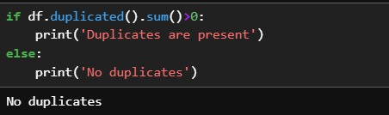
Data Cleaning
Ensure no duplicates in the data to avoid:
Ensure correct data types for accurate analysis:
Inaccurate analysis
Order Date and Ship Date were changed to Datetime format
Skewed insights
Extracted Year from Order Date into a separate column
Misleading conclusions
This enables proper sorting, filtering, and time-based analysis

Slide 14
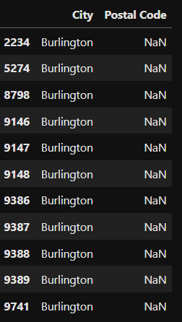
Data Cleaning
Handling Nulls:
Found null values in the Postal Code for the state Vermont

Slide 15
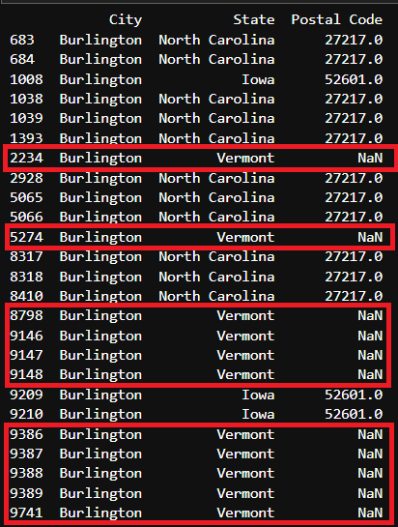
Data Cleaning
Handling Nulls:
Used the mode to find the most frequent Postal Code in Burlinton city
Filled the nulls in Vermont with the most common Postal Code

Slide 16
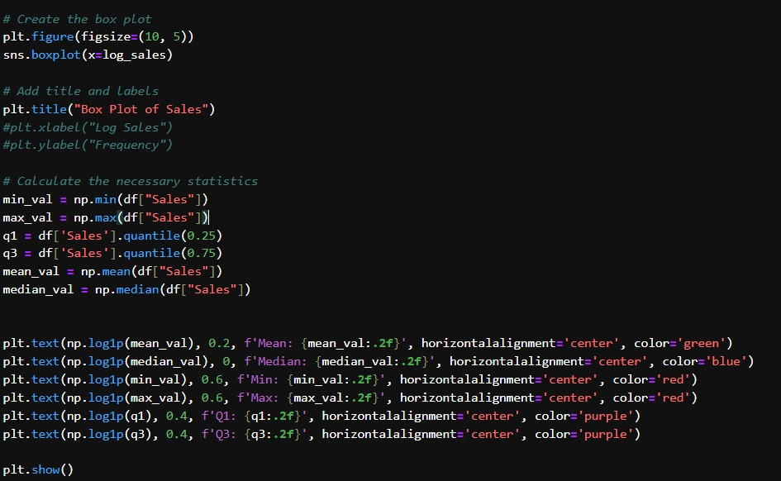
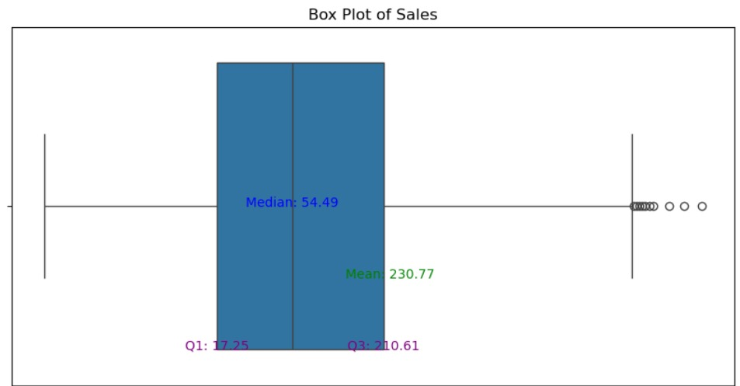
Data Cleaning
Outliers:
The box plot shows the distribution of sales values.
The median sales is 54.49, meaning half of the sales are below this value.
The mean is 230.77, suggesting the presence of higher values skewing the distribution.
Outliers on the right indicate unusually high sales, which may represent exceptional transactions.
These outliers should be analyzed further to identify any unique patterns or anomalies.

Slide 17
Why Analyzing Outliers Matters?
Spot Unusual Data: Outliers can highlight errors or special events.
Boost Accuracy: Removing outliers makes the analysis more reliable.
Find Opportunities: Outliers may point to new business insights.

Slide 18

DESIGN
EXLPORE

Slide 19



Table of Content
CUSTOMER
PRODUCT

Slide 20

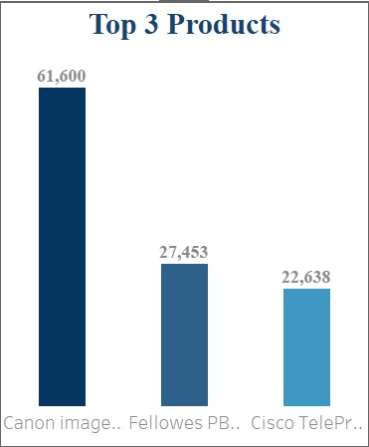
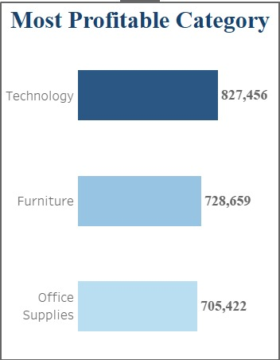
PRODUCT ANALYSIS
Select Top 3 [Product Name] , sum(sales) Total_Sales
From superstore
Group by [Product Name]
Order by Total_Sales Desc
Top 3 Products by Sales Analysis:
Canon is the top-selling product, with total sales of 61,600.
Followers ranks second, with total sales of 27,453.
Cisco is third, achieving total sales of 22,638.
EXPLORE

Slide 21
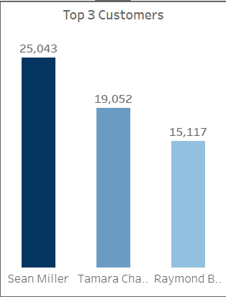
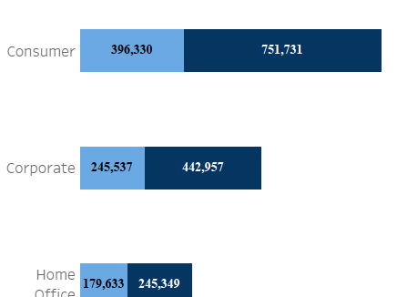
CUSTOMER Analysis
Select top 3 [Customer Name] , sum(sales) Total_Sales
From superstore
Group by [Customer Name]
Order by Total_Sales Desc
Top 3 Customers by Sales Analysis:
Sean Miller is the top customer, with total sales of 25,043.
Tamara ranks second, with total sales of 19,052.
Raymond is third, achieving total sales of 15,117.
EXPLORE

Slide 22
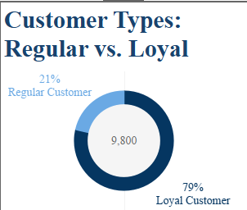
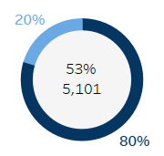

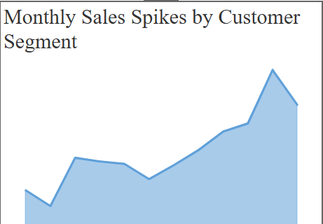
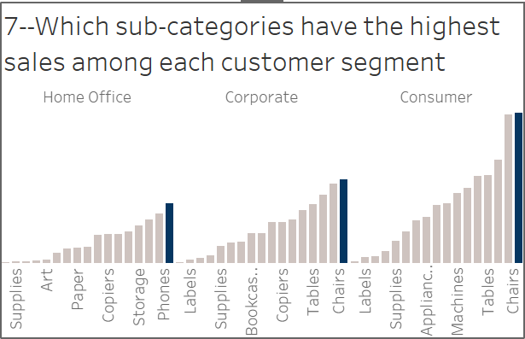
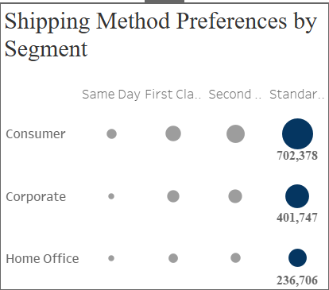
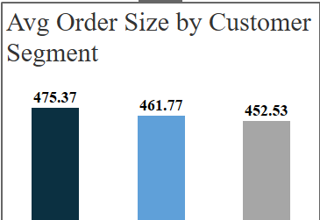
Select Segment , Round(sum(sales),3) Total_Sales
From superstore
Group by segment
Order by Total_Sales Desc
Most Profitable Segments by Total Sales:
Consumer Segment: Total sales of 1,148,060.
Loyal customers contribute 751,731.
Regular customers contribute 396,330.
Corporate Segment: Total sales of 688,494.
Loyal customers contribute 442,957.
Regular customers contribute 245,537.
Home Office Segment: Total sales of 424,982.
Loyal customers contribute 245,349.
Regular customers contribute 179,633.
01
02
03

Slide 23
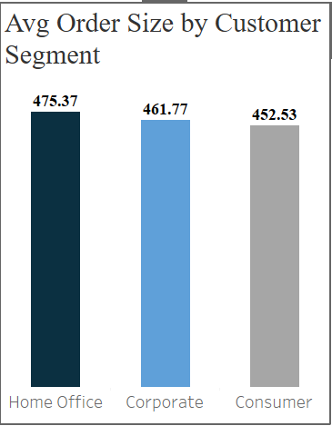
Select Segment , Round(Sum(sales)/COUNT(Distinct [order ID]),2) average_order_size
From superstore
Group by segment
Order by average_order_size
Average Order Size by Customer Segment:
Home Office Segment has the highest average order size at 475.37.
Corporate Segment follows with an average order size of 461.77.
Consumer Segment has an average order size of 452.53.
02
03
04

Slide 24
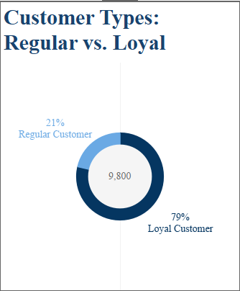
SELECT
[Customer Type],
COUNT([Count of Orders per Customer]) AS Customer_Count,
ROUND((
COUNT([Count of Orders per Customer]) * 100.0
/ (SELECT COUNT([Count of Orders per Customer])
FROM superstore)), 2) AS Percentage
FROM
superstore
GROUP BY
[Customer Type];
03
04
05

Slide 25
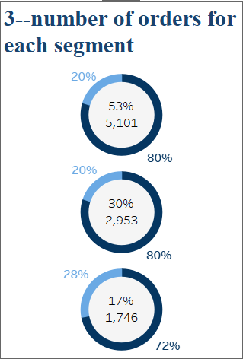
SELECT
Segment,
COUNT(*) AS Customer_Count,
ROUND((COUNT(*) * 100.0 / (SELECT COUNT(*) FROM Superstore)), 2) AS Percentage
FROM
Superstore
GROUP BY
Segment
ORDER BY
Segment;
04
05
06

Slide 26
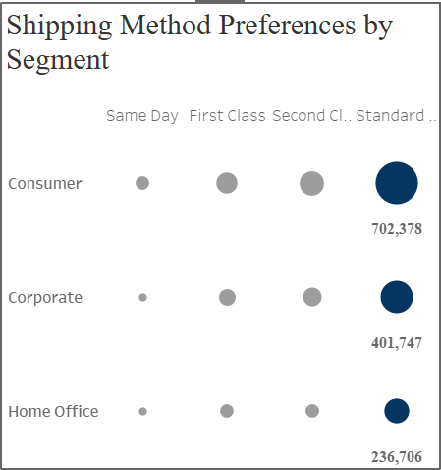
SELECT
Segment, [ship mode],
count([order id]) order_count,
sum(sales)
FROM cleaned_date2`
GROUP BY Segment, [ship mode]
order by segment , order_count desc
05
06
07

Slide 27

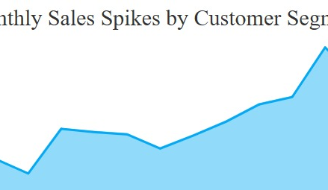
WITH RankedSubCategories AS (
SELECT Segment, [Sub-Category],
SUM(Sales) AS Total_Sales,
ROW_NUMBER() OVER (PARTITION BY Segment ORDER BY SUM(Sales) DESC) AS Rank
FROM Superstore
GROUP BY
Segment, [Sub-Category])
SELECT
Segment,
[Sub-Category],
Total_Sales
FROM
RankedSubCategories
WHERE
Rank = 1;
06
07

Slide 28
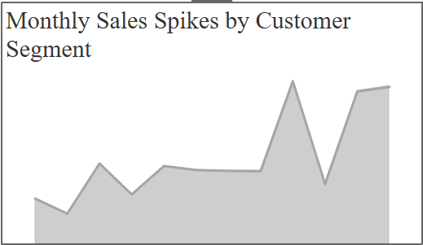
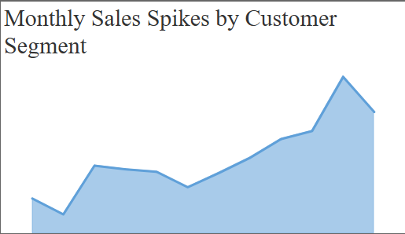
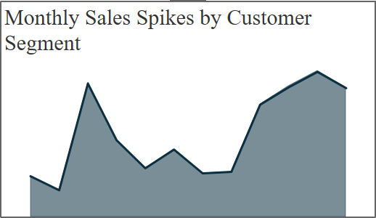
Consumer
Corporate
Home Office
WITH MonthlySales AS (SELECT
segment,YEAR([Order Date]) AS OrderYear,MONTH([Order Date]) AS OrderMonth,SUM(Sales) AS TotalSales
FROM cleaned_data2
GROUP BY YEAR([Order Date]), MONTH([Order Date]) ,Segment),
RankedSales AS (SELECT Segment,OrderYear,OrderMonth,TotalSales,
RANK() OVER (PARTITION BY OrderYear,Segment ORDER BY TotalSales DESC) AS SalesRank
FROM MonthlySales)
SELECT Segment,OrderYear,OrderMonth,TotalSales
FROM RankedSales WHERE SalesRank <= 3 ORDER BY OrderYear, Segment,TotalSales desc
07

Slide 29
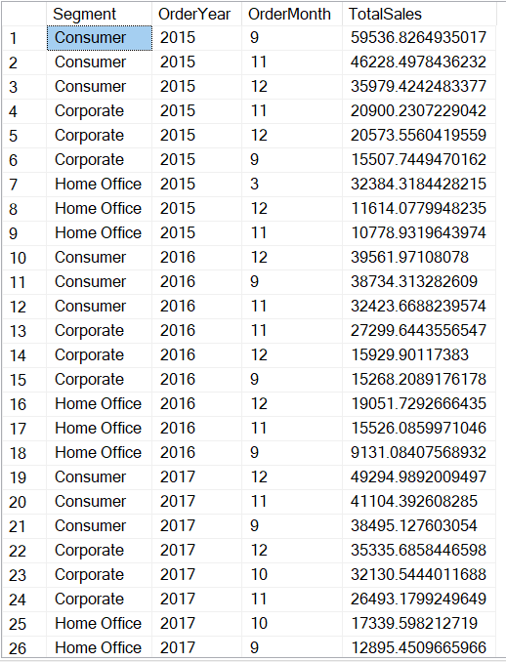
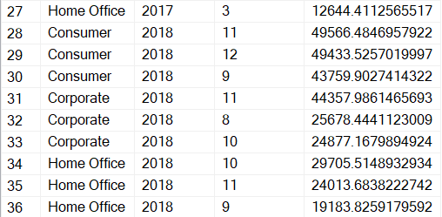
Highest sales months each year are September , November, and December.(Segment)
Possible Reasons:
September: Back-to-school season.
November and December: Holiday shopping and year-end promotions.
Strategies to Boost Sales:
Increase Marketing: Focus campaigns during these months.
Offer Discounts: Use limited-time deals to encourage purchases.
Prepare Inventory: Stock up on popular products.
Engage Customers: Use personalized offers to encourage repeat purchases.
Boost Online Presence: Promote offers through social media and email.

Slide 30
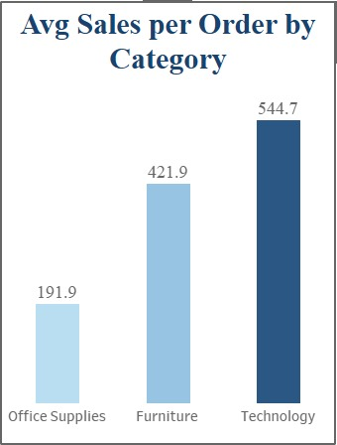
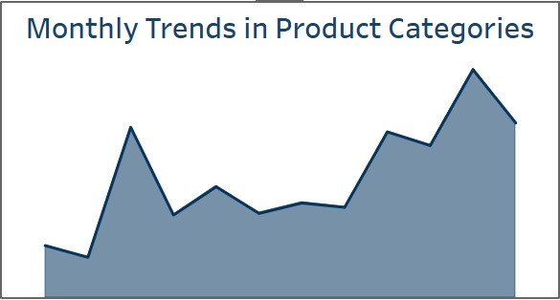
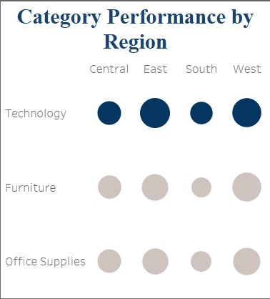
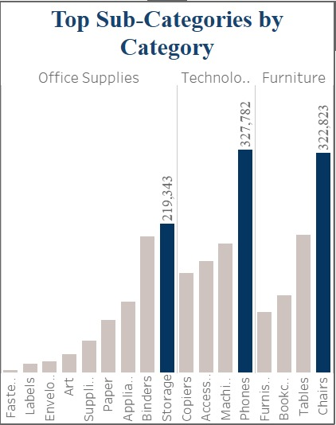
PRODDUCT
CATEOGRY
select category
, round(sum(sales),3) Total_Sales
from superstore
group by category
order by Total_Sales desc
01
02
03

Slide 31
PRODDUCT
SUB-CATEOGRY
WITH RankedSales AS (
select category
, [sub-category]
, round(sum(sales),3) Total_Sales
, row_number() over(partition by category
order by round(sum(sales),3) desc) as Sales_Rank
from cleaned_date2
group by category, [Sub-Category], Total_Sales
Select category , [sub-category] , Total_Sales
From RankedSales
Where Sales_Rank = 1
order by total_sales desc
02
03
04

Slide 32
select Region
,Category
,round(sum(sales),2) Total_Sales
,DENSE_RANK() over(partition by Region order by round(sum(sales),2) desc) as Sales_Rank
from superstore
group by Region
,Category
order by Region , Sales_Rank
Category performance
03
04
05

Slide 33
Avg sales by category
SELECT Category, ROUND(SUM(sales) / COUNT(DISTINCT [Order ID]), 1) AS avg_sales_per_order
FROM superstore
GROUP BY Category
ORDER BY avg_sales_per_order DESC
04
05

Slide 34
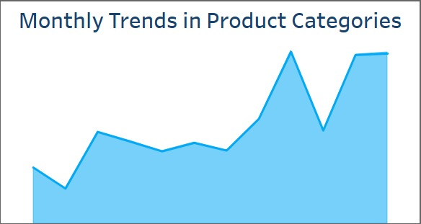
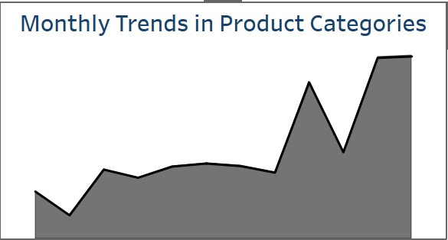
Technology
Office Supplies
Furniture
WITH MonthlySales AS ( SELECT Category, YEAR([Order Date]) AS OrderYear, MONTH([Order Date]) AS OrderMonth, SUM(Sales) AS TotalSales
FROM cleaned_data2
GROUP BY YEAR([Order Date]), MONTH([Order Date]), Category ),
RankedSales AS ( SELECT Category, OrderYear, OrderMonth, TotalSales,
RANK() OVER ( PARTITION BY OrderYear, Category ORDER BY TotalSales DESC) AS SalesRank
FROM MonthlySales )
SELECT Category, OrderYear, OrderMonth, TotalSales
FROM RankedSales WHERE SalesRank <= 3 ORDER BY OrderYear, Category, TotalSales DESC;
05

Slide 35
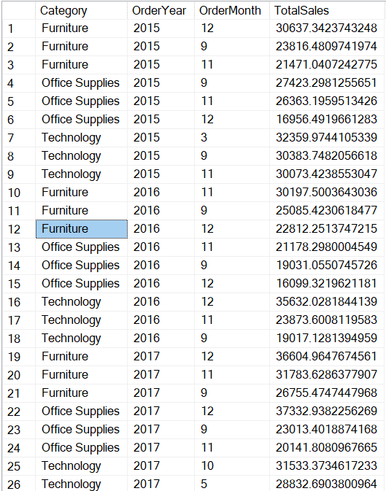
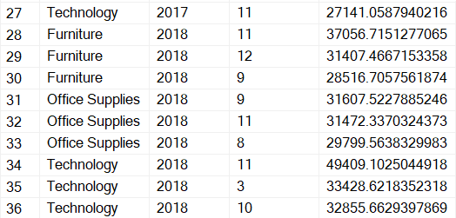
Highest sales months each year are September , November, and December. (Category)

Slide 36
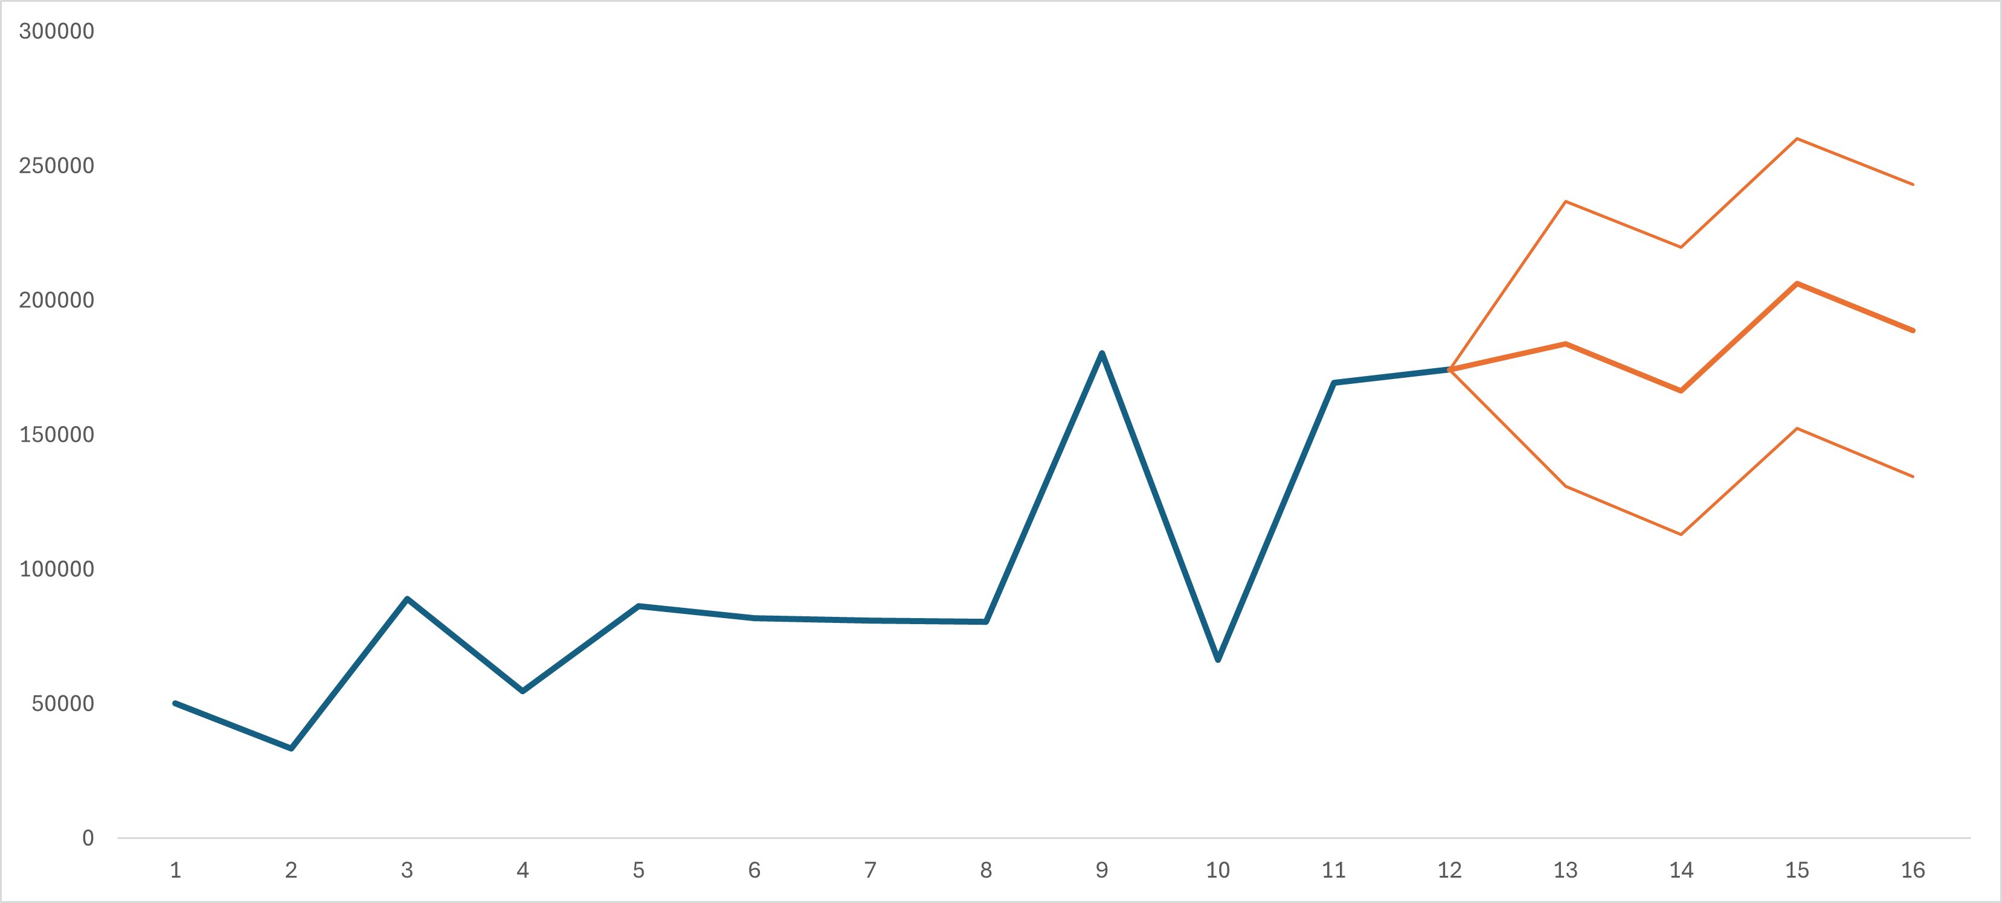
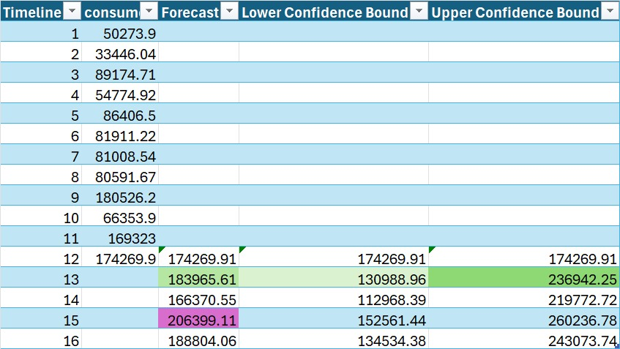
Forcasting
Forecast Overview: The chart predicts future consumer values, showing a generally increasing trend.
Confidence Bounds: The orange lines indicate possible ranges, with wider gaps showing more uncertainty.
Key Insights:
Growth Expected: Consumer values are expected to rise over time.
Peak in March: The forecast shows the highest values around March, approximately 206,399.
Uncertainty Increases: The range of predictions becomes broader as time progresses, suggesting more variability.

Slide 37
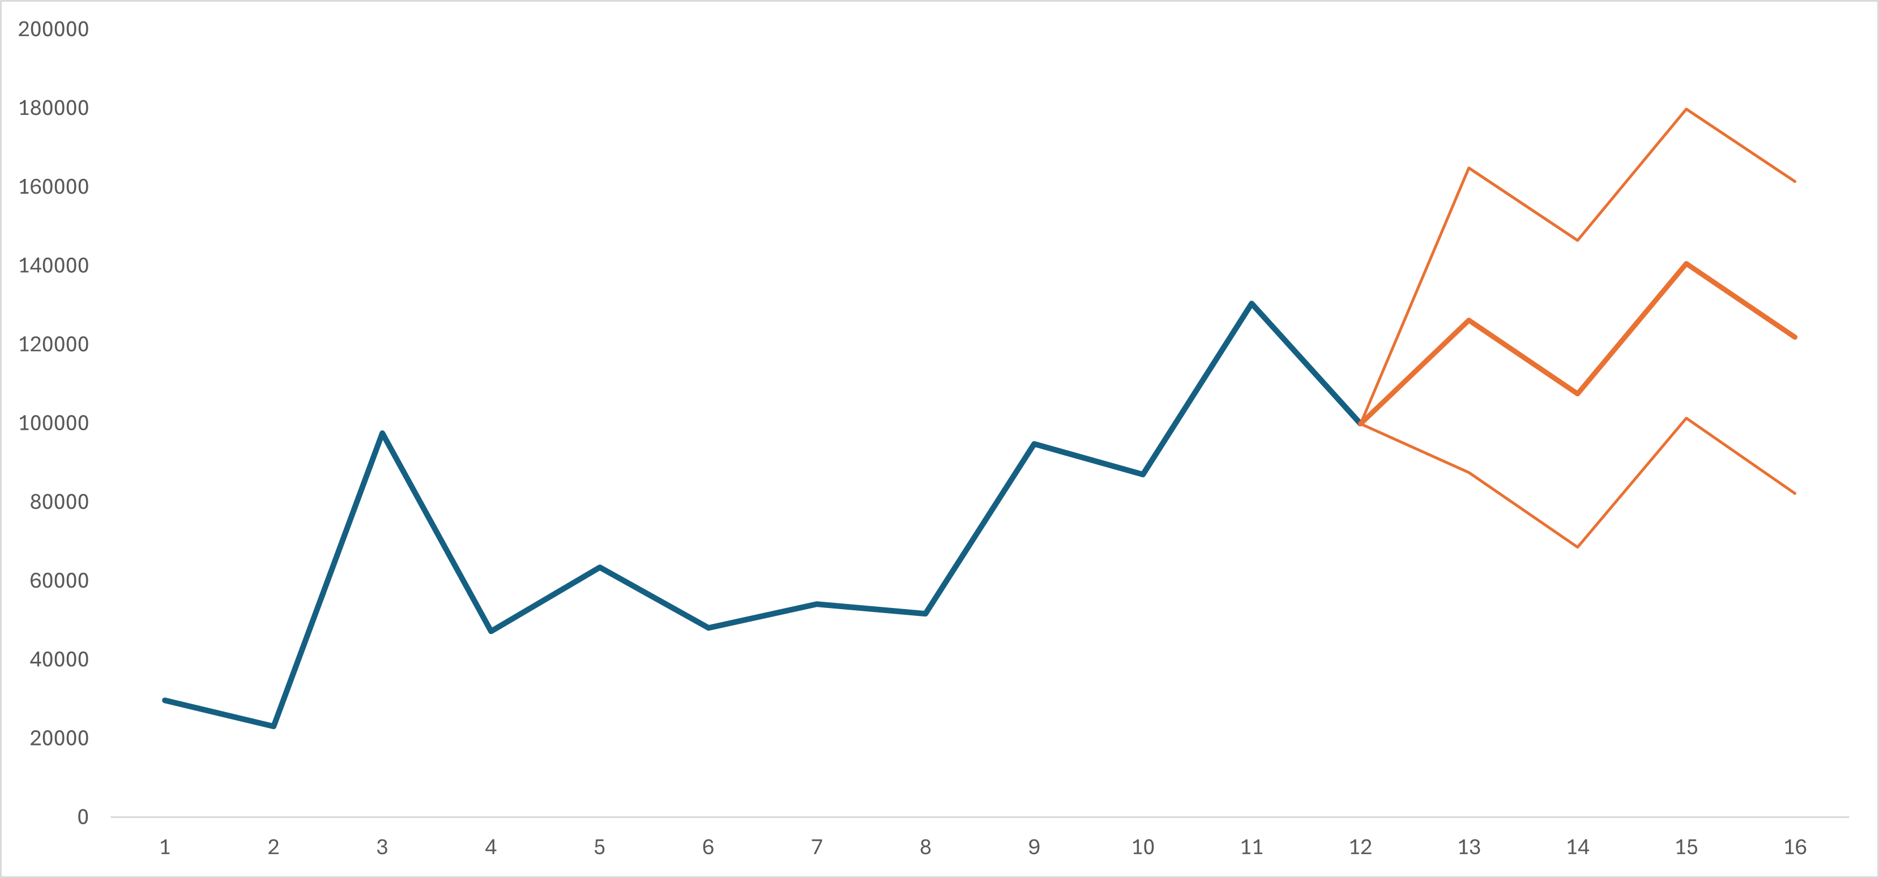
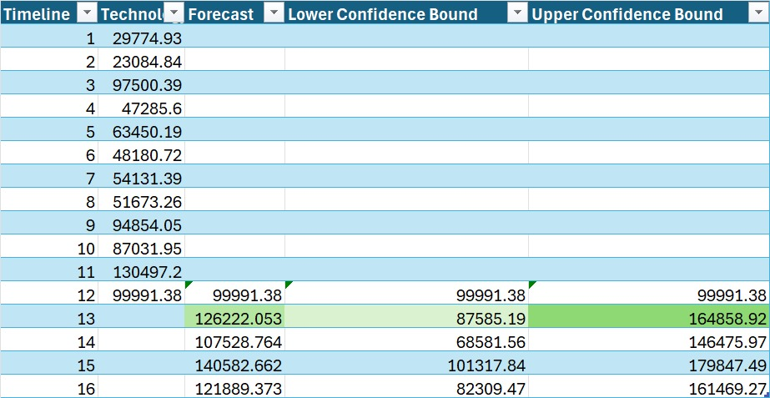
Forcasting
Forecast Overview: The chart predicts future technology values with an upward trend.
Confidence Bounds: The orange lines show the possible range of values, with a wider range indicating more uncertainty.
Key Insights:
Steady Growth: Technology is expected to grow steadily over time.
Peak Prediction: The highest forecasted value is in March, around 140,583..
Increasing Uncertainty: The range of possible values widens in future months.

Slide 38
Product Categories:
Profitability analysis, best-selling sub-categories, regional performance,
sales spikes during specific months, and average sales per order.
Customer Behavior:
Revenue by customer segment, order size, repeat purchases, shipping
preferences, seasonal behavior, and top-selling sub-categories for each
segment.
Customer Records: Detailed customer order histories and records.
visualization
We created three dashboards using Tableau:

Slide 39
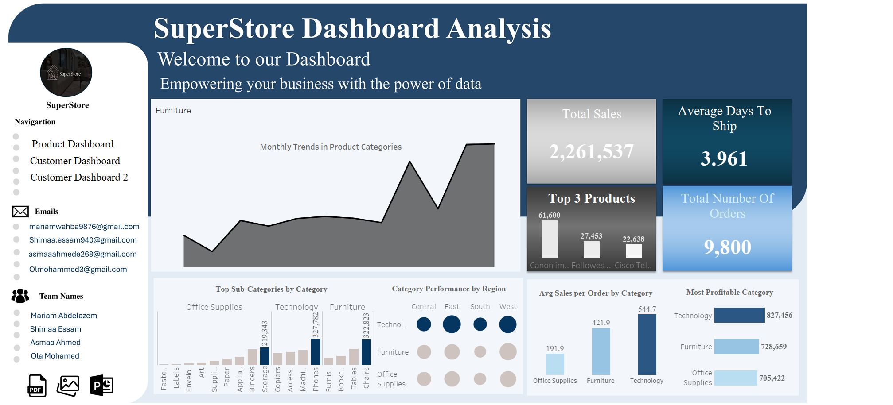

Slide 40
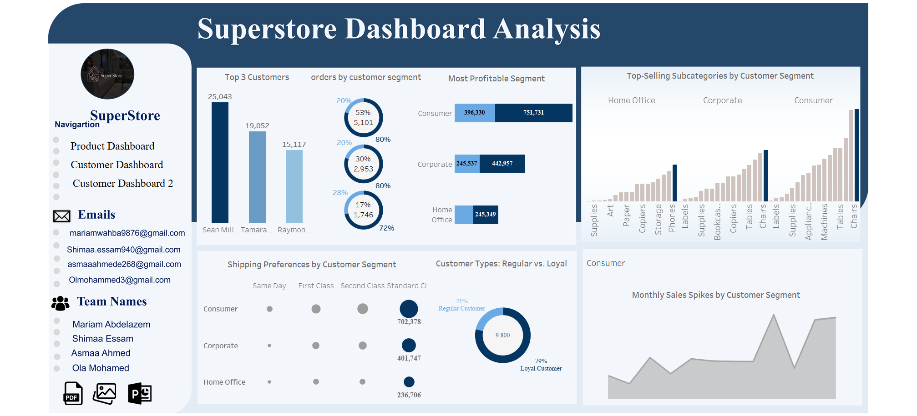

Slide 41
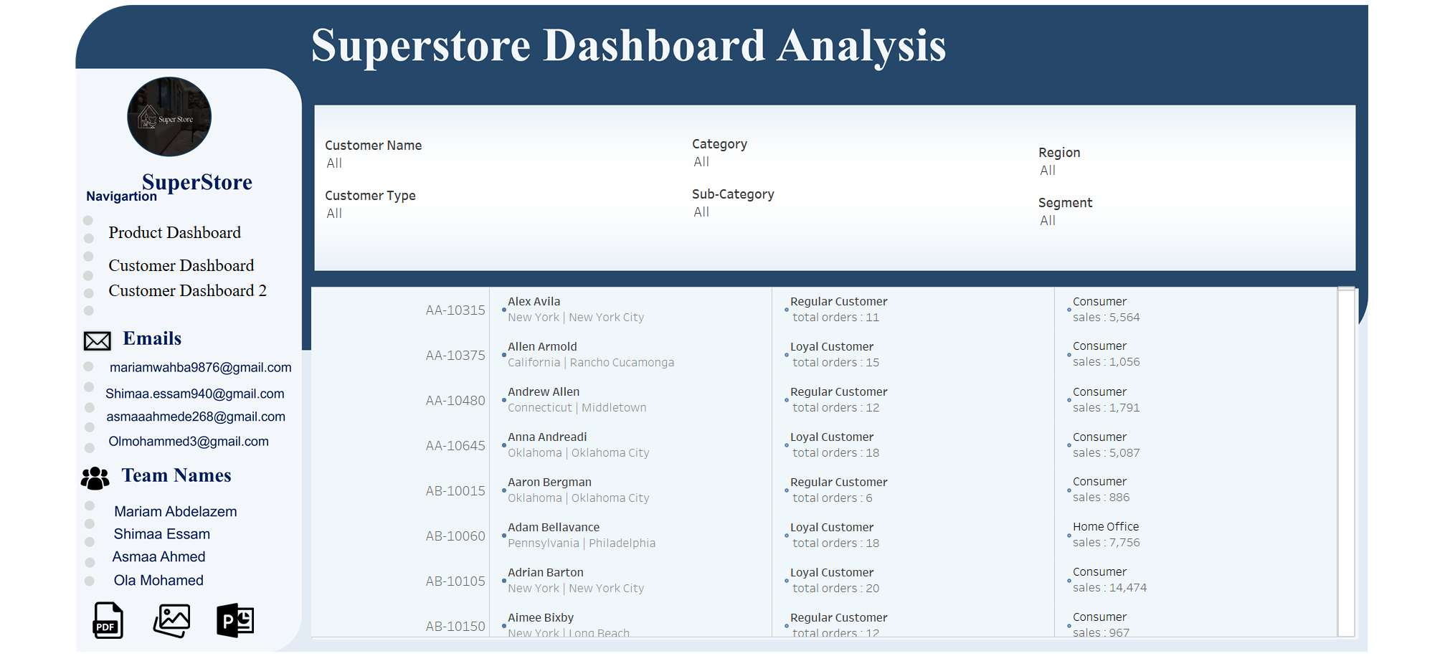
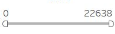
Customer type
Customer IDd
Total sales

Slide 42
Recommendations
Product Categories
Focus on Most Profitable Categories
Optimize Inventory for Best-Selling Sub-Categories
Target Underperforming Regions
Capitalize on Seasonal Spikes

Slide 43
Recommendations
Customer Behavior
Prioritize High Revenue Segments
Encourage Repeat Purchases
Tailor Shipping Options
Seasonal Promotions

Slide 44
Recommendations
Customer Records
Personalize Marketing Campaigns
Improve Customer Retention

Slide 45
Conclusion
This PowerPoint summarizes the Superstore dataset analysis.
Focuses on customer behavior, product performance, and sales forecasting.
Provides insights for better targeting and product optimization.
Includes tools for predicting demand, managing inventory, and guiding marketing efforts.
Offers strategies for revenue growth and improved customer satisfaction.

Slide 46
Thank You

